Slide 1
Overview
Practical Tuning Issues

Slide 2
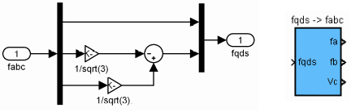
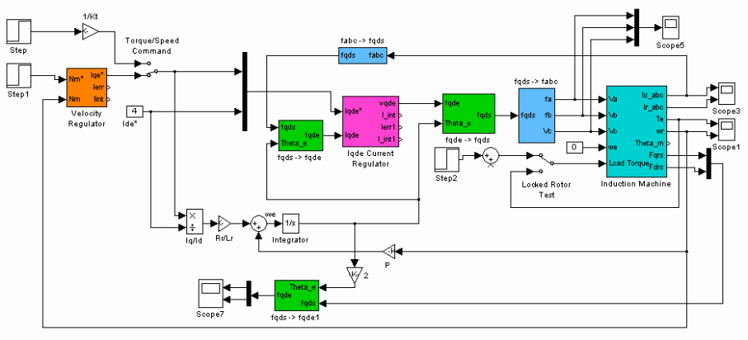
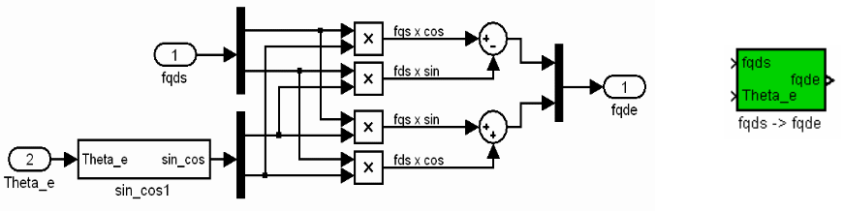
Recap:
Overview
Overview
Electric machine modeling: BLDC, PM
Motor control theory/modeling, BLDC commutation, synchronous frame current regulation, space vector theory etc…
Theory
Design
Example
Observations
Conclusion

Slide 3
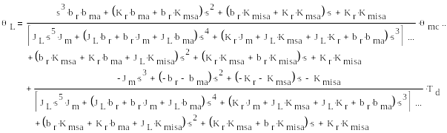
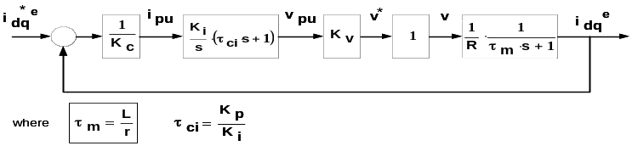

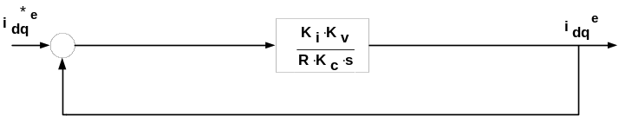
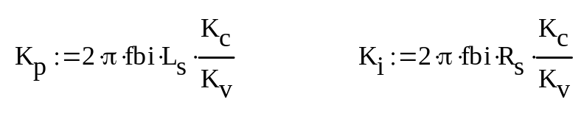

Recap:
Overview
Overview
System control modeling, deriving/calculating gains etc…
Theory
Design
Example
Observations
Conclusion

Slide 4

Recap:
Overview
Overview
Theory
Plug in gains and ship to customer?
Design
Example
Not exactly…first TWEAK the gains!
Errors in model, or measurement will create errors in predicted response!
To get an ideal (perfect) response you require a perfect model! This is never the case!
Observations
Conclusion

Slide 5

Recap:
Overview
Overview
Theory
But there’s more to tweaking gains than pure guesswork!
Know your system (plant)
Know your controller
Investigate simple PI control
Design
Example
Observations
Conclusion
Determine what gains to change based on step response or frequency response!

Slide 6
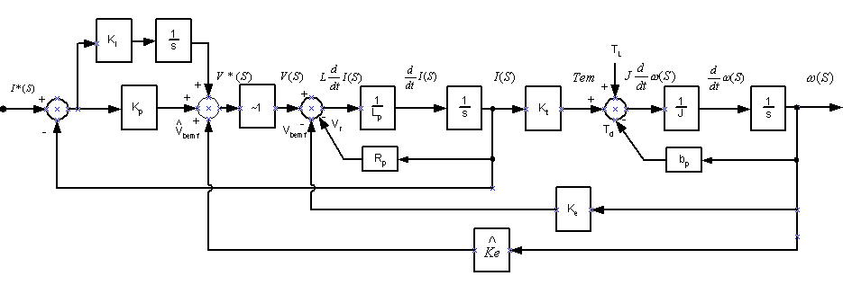
Control Structure
Overview
Theory
Theory
Design
Example
Observations
Conclusion
Current Loop
Implement simple pole zero cancellation with motor pole and controller zero
Calculated bandwidth of 1000Hz
Investigate 3 cases…

Slide 7
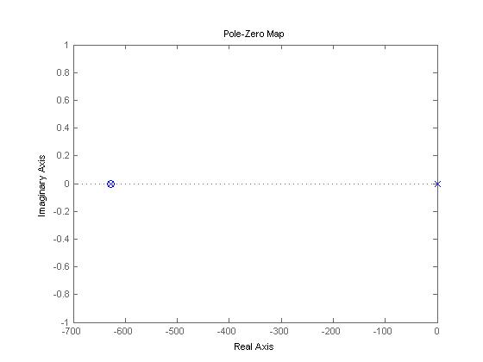
“Tweaking the Gains”
Overview
Case 1 – Perfect Pole Zero Cancellation
Theory
Theory
Theory
Design
Example
Observations
Controller Zero
Conclusion
Controller Pole at origin
Motor Pole
Current Regulator Pole Zero Locations

Slide 8
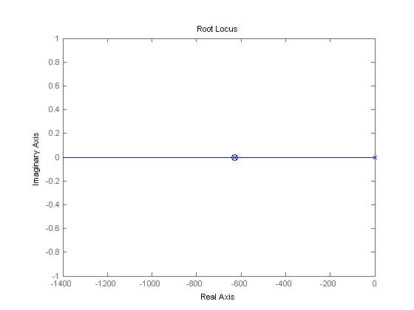
“Tweaking the Gains”
Overview
Case 1 – Perfect Pole Zero Cancellation
Theory
Theory
Theory
Theory
Design
Example
Observations
Conclusion
Resulting Single Pole
Current Regulator Root Locus

Slide 9
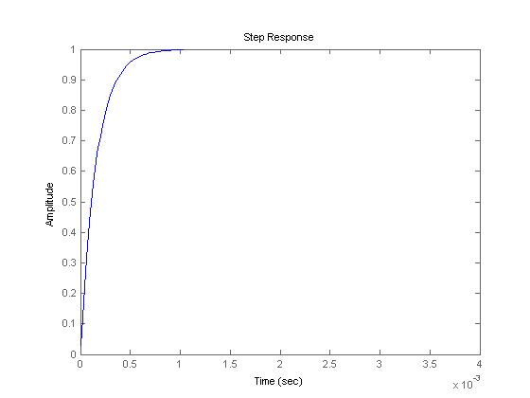
“Tweaking the Gains”
Overview
Case 1 – Perfect Pole Zero Cancellation
Theory
Theory
Theory
Theory
Design
Example
Observations
Conclusion
1ms Response Time
Critically Damped
1st order response
Current Regulator Step Response

Slide 10
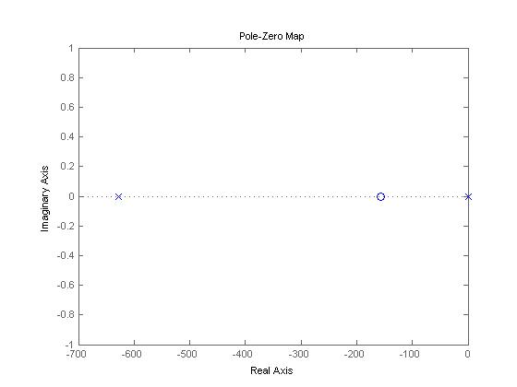
“Tweaking the Gains”
Overview
Case 2 – Cancellation (Controller) zero misses on the right
Theory
Theory
Theory
Theory
Design
Example
Observations
Controller Zero
Controller Pole
Conclusion
Controller Pole at origin
Motor Pole
Controller Pole at origin
Motor Pole
Current Regulator Pole Zero Locations

Slide 11
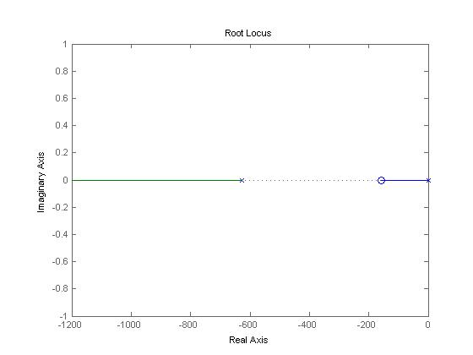
“Tweaking the Gains”
Overview
Case 2 – Cancellation (Controller) zero misses on the right
Theory
Theory
Theory
Theory
Design
Example
Observations
2 Distinct Real Poles
Conclusion
Increasing Overall Gain Pushes Pole out
Current Regulator Root Locus

Slide 12
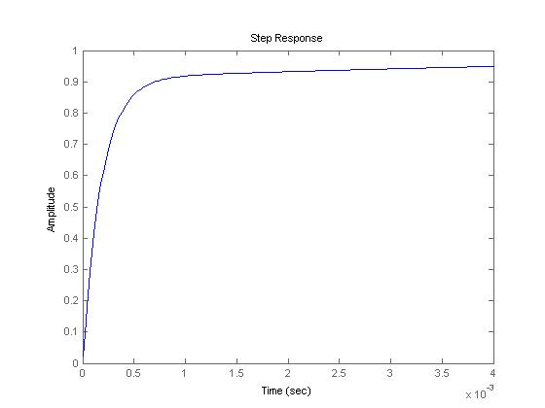
“Tweaking the Gains”
Overview
Case 2 – Cancellation (Controller) zero misses on the right
Theory
Theory
Theory
Theory
Design
Example
Observations
Conclusion
Overdamped Response
2 Distinct Time Constants!
Current Regulator Step Response

Slide 13
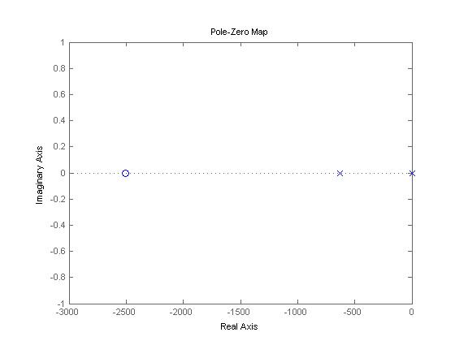
“Tweaking the Gains”
Overview
Case 3 – Cancellation (Controller) zero misses on the left
Theory
Theory
Theory
Theory
Design
Example
Observations
Motor Pole
Conclusion
Controller Pole at origin
Controller Pole
Current Regulator Pole Zero Locations

Slide 14
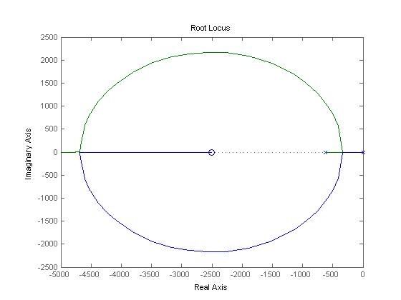
“Tweaking the Gains”
Overview
Case 3 – Cancellation (Controller) zero misses on the left
Theory
Theory
Theory
Theory
Design
Example
Observations
2 Distinct Complex Poles
Conclusion
Current Regulator Root Locus

Slide 15
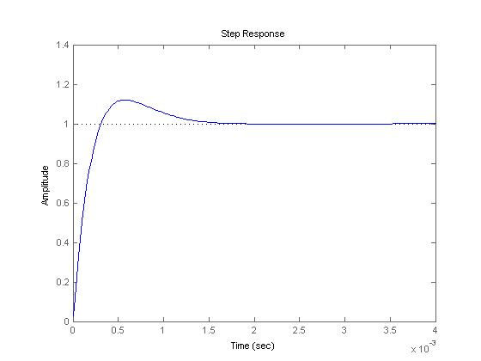
“Tweaking the Gains”
Overview
Case 3 – Cancellation (Controller) zero misses on the left
Theory
Theory
Theory
Theory
Design
Example
Observations
Conclusion
Underdamped 2nd order Response
Current Regulator Step Response

Slide 16
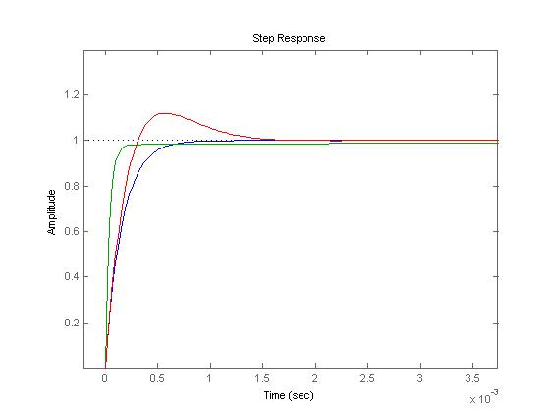
“Tweaking the Gains”
Overview
Theory
Observations:
Controller Zero: -K_{i}/K_{p}
Theory
Theory
Theory
Design
Example
Observations
Conclusion
Location of controller zero depends on ratio of K_{i}/K_{p}
Determines the shape of response
K_{i}/K_{p} < C
K_{i}/K_{p} = C
K_{i}/K_{p} > C

Slide 17
“Tweaking the Gains”
Overview
Theory
Once shape of response has been tuned…
Theory
Theory
Theory
…Overall gain K*(K_{i}/K_{p})
How does this effect the response?
Design
Example
Observations
Conclusion
Overall gain pushes poles along the root locus!

Slide 18
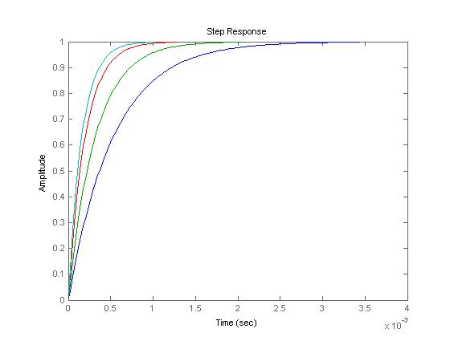
“Tweaking the Gains”
Overview
Theory
Overall gain (K) – Critically Damped Response
Theory
Theory
Theory
Design
Example
Observations
Conclusion
Increasing K

Slide 19
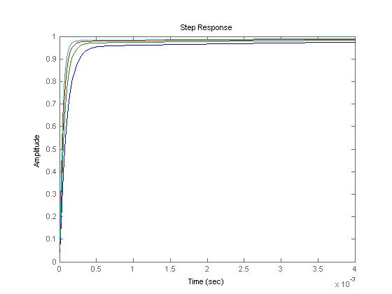
“Tweaking the Gains”
Overview
Theory
Overall gain (K) – Overdamped Response
Theory
Theory
Theory
Design
Example
Observations
Conclusion
Increasing K

Slide 20
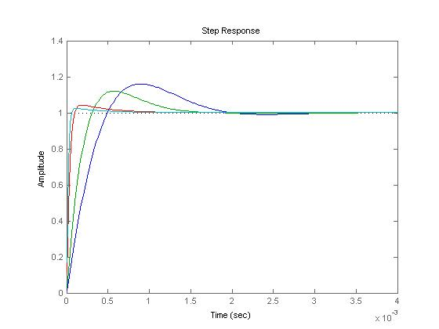
“Tweaking the Gains”
Theory
Overall gain (K) – Underdamped Response
Theory
Theory
Increasing K
Can actually reduce overshoot by increasing gain!

Slide 21
“Tweaking the Gains”
Theory
Observations
Theory
Theory
Increasing overall gain (K) increases the speed of response
Does not generally effect shape*
*with the exception of underdamped response and very high gains!

Slide 22
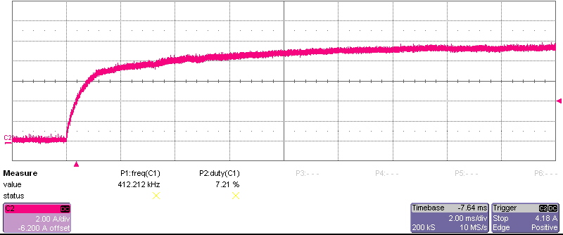
Actual Tuning Results
Size “L” Motor
Sine Drive Controller
Calculated gains for 1000Hz
Design
Example
Response overdamped, adjust ratio of gains until desired response

Slide 23
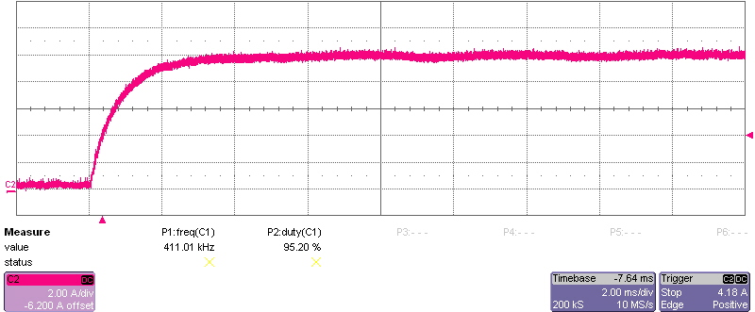
Actual Tuning Results
After “tweaking” gain ratio…
Design
Example
Response is now critically damped!

Slide 24
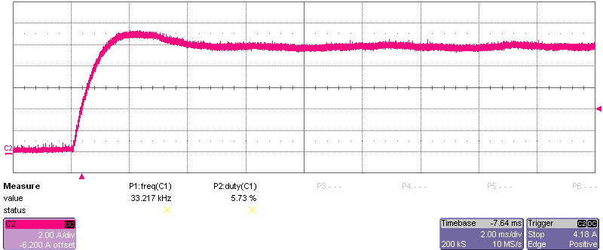
Actual Tuning Results
And for completeness…
Design
Example
Adjusting Ki/Kp to show underdamped response

Slide 25
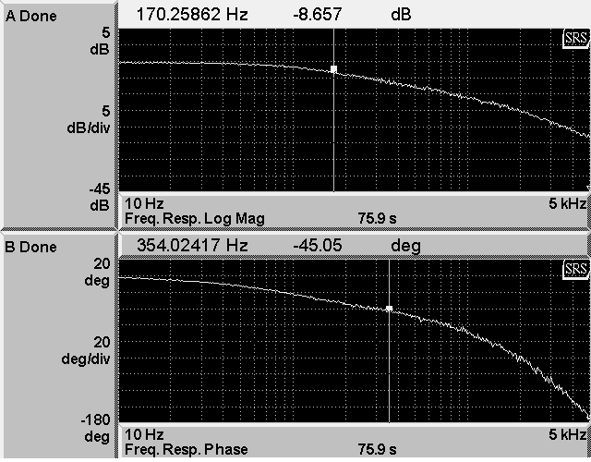
Actual Tuning Results
Bandwidth Test
Design
Example
Frequency response much lower than predicted!
Even with ideal step response…

Slide 26
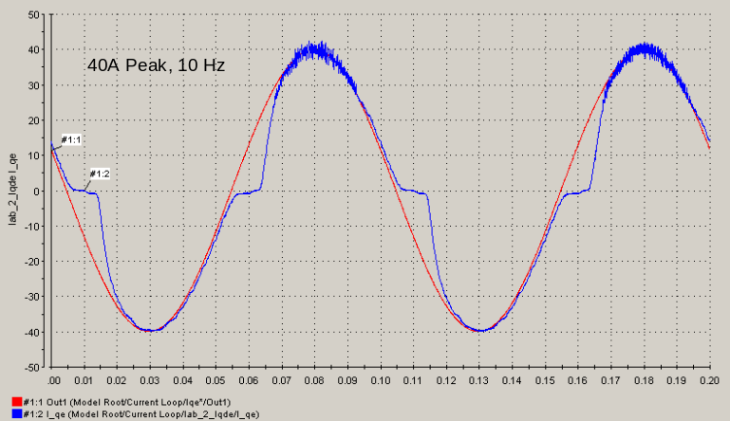
Actual Tuning Results
Bandwidth Test
Low bandwidth caused by dead-time
Any drive with complimentary switching requires dead time (ie: 4Q BLDC, sine drives)
Design
Example
Dead time causes non-linearities about zero, this produces delay in overall response

Slide 27
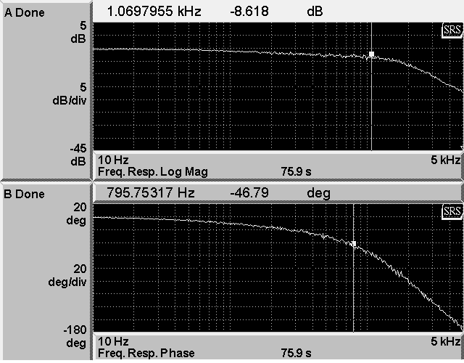
Actual Tuning Results
Bandwidth Test
Using dead-time compensation…
Design
Example
Bandwidth now agrees with predicted results

Slide 28
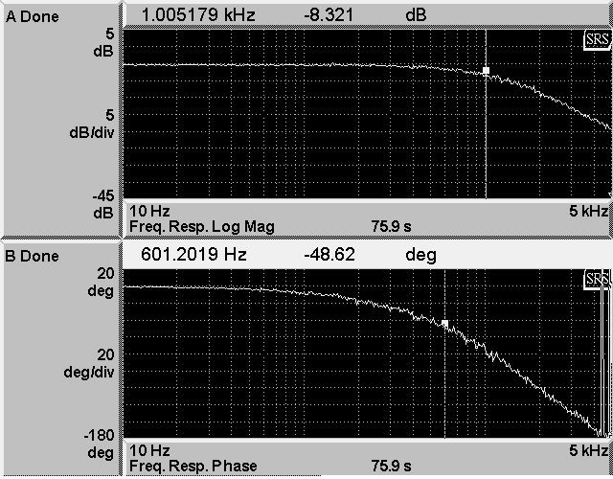
Actual Tuning Results
Bandwidth Test
To avoid these non-linearities, offset the command to avoid zero crossings
Acceptable for fans/pumps etc…
Servo drives should be centered about zero
Design
Example
Offset command without compensation
Bandwidth test should reflect how the drive will be operated!

Slide 29
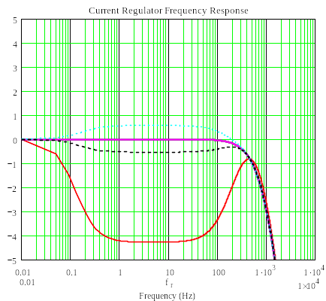

Actual Tuning Results
Bandwidth Test – Side Note
Current response tuned at locked rotor
May not achieve same response at speed!
Bemf Decoupling
Design
Example

Slide 30
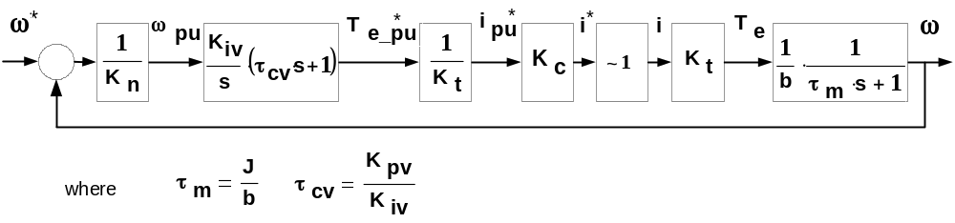
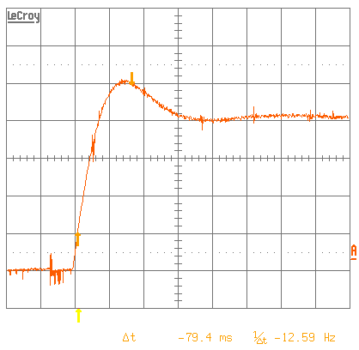
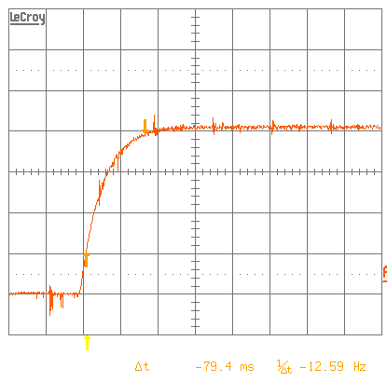
Actual Tuning Results
Rate Loop Tuning
Design
Example
Tuning for 50Hz
Ki/Kp to high
Rise time to slow (Increase K)
Several iterations of adjusting K_{i} and K_{p}…

Slide 31
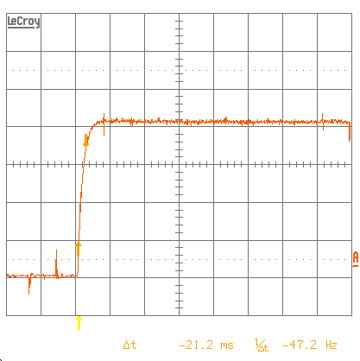
Actual Tuning Results
Rate Loop Tuning
Design
Example
…Final Response Tuned for ~50Hz

Slide 32
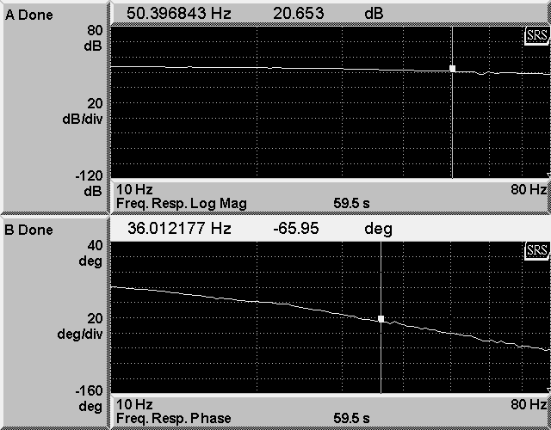
Actual Tuning Results
Rate Loop Tuning – Frequency Response
Design
Example
…Final Response Tuned for ~50Hz

Slide 33
Observations
Rate Loop Tuning
If loop bandwidths close in frequency oscillatory response may occur…
Observations
Another Pole Appears!

Slide 34
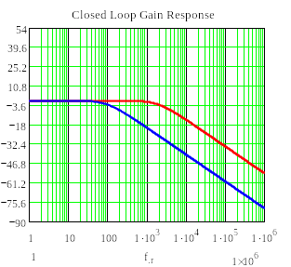
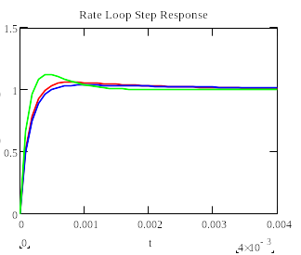
Observations
Current Loop
Rate Loop Tuning
Rate Loop
Observations
Loop Dynamics
Increasing rate loop dynamics
Rate Loop Step Response
Practically this is even worse as we rarely have perfect pole/zero cancellation

Slide 35
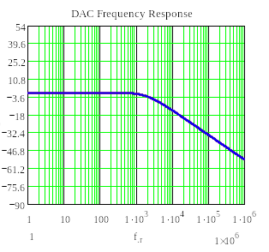
Observations
General Frequency Response
System may have added delays in measurement/feedback that cause inaccurate delays in system (DAC, A2D etc…)
Design
Example
Observations
DAC rolls off at ~2kHz!

Slide 36
Observations
If we can tweak the gains from actual results do we even need a model to predict gains??
Observations
…Practically speaking, no. However, model helps determine starting point.
Only discussed the simplest case…many other systems are more complex.

Slide 37
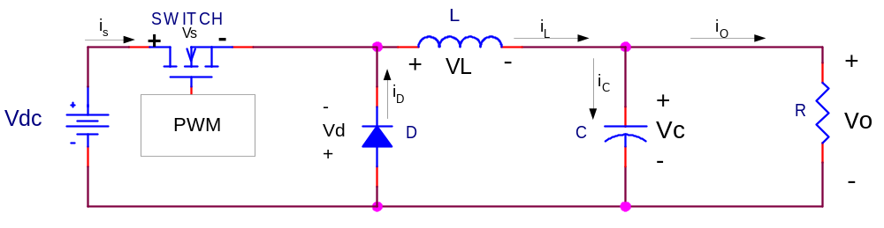
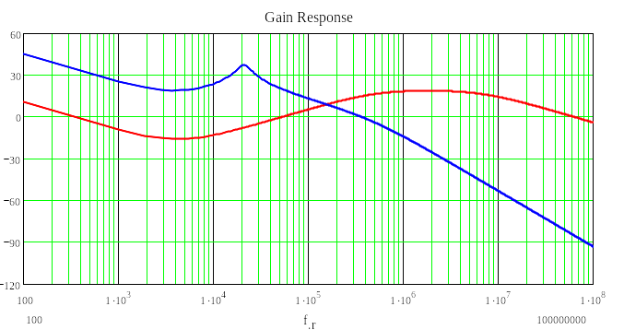
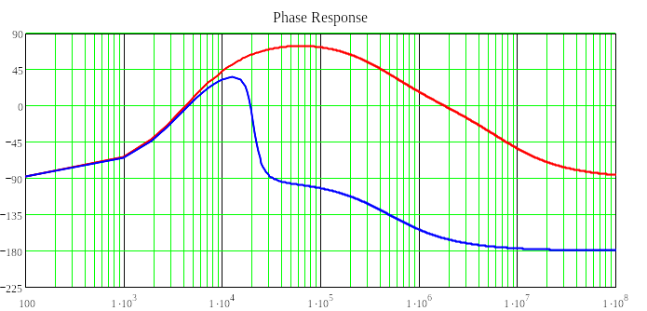
Observations
Complex Systems…resonant loads!
LC Resonant Load
Observations
Simple case…the buck converter
Require at least 2 zero, 1 pole compensation (for b/w higher than resonance)

Slide 38
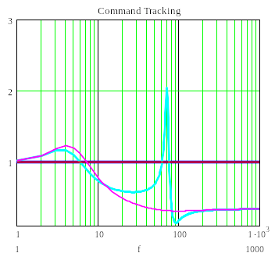
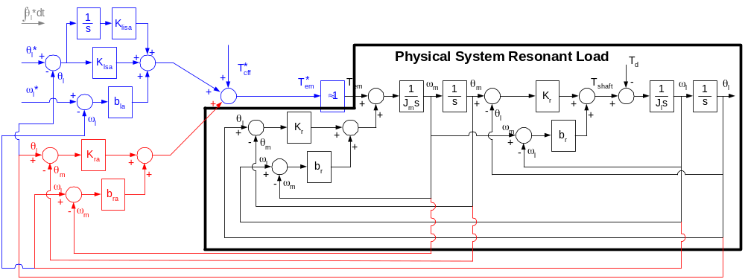
Observations
Complex Systems…resonant loads!
Observations
Compliant systems between actuator and motor
Require active resonant damping, advanced filters, mechanical redesign?

Slide 39
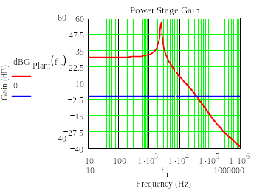
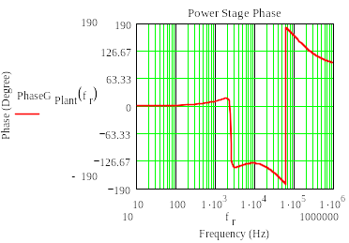
Observations
Complex Systems…loads with right half plane zeros!
Observations
Resonant Poles
RHPZ (increase in gain, decrease in phase)
Any boost type converter (Active rectifiers, flyback power supplies, etc…)
Require more complex compensation techniques

Slide 40
Conclusion
For 2nd order systems, we can predict and modify the gains for achieve our desired response
Outer loops can be tuned easily, providing they are far enough away
Complex systems require more complicated controllers
Conclusion
?

